Slide 1
Dana Penelitian Perusahaan Startup
MATH 1042 – PROYEK 4 – KELOMPOK 7

Slide 2
PENGANTAR
Terdapat permasalahan mengenai tingkat kepentingan Divisi R&D bagi profit suatu perusahaan
Kelompok kami akan melakukan analisa mengenai permasalahan profit dari perusahaan dan kaitannya dengan biaya R&D, Administrasi, dan Marketing.
Diharapkan melalui Analisa ini dapat memberikan konklusi terbaik untuk menjawab pertanyaan tentang seberapa penting peran divisi Penelitian dan Pengembangan (R&D) dalam sebuah perusahaan startup.

Slide 3




PERALATAN STATISTIKA
01
02
03
04

Slide 4
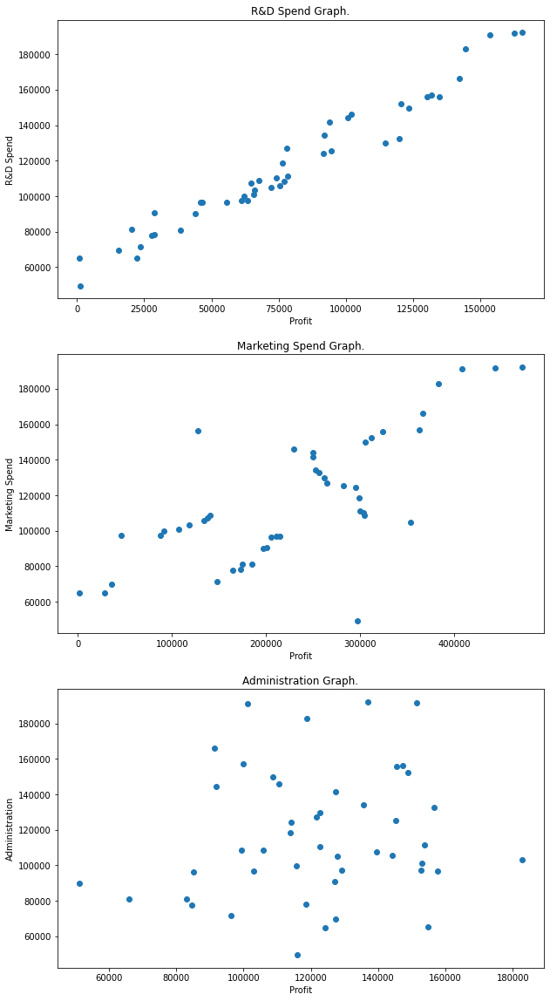
GRAFIK HUBUNGAN

Slide 5
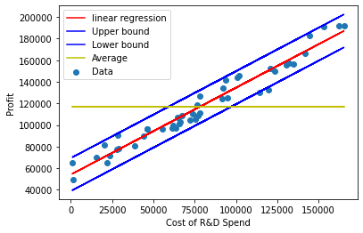
R&D Spend
$$Rumus regresi linear = 0.8046215878369701∗x_{1} + 54108.9498101553$$
$$Batas atas : 0.8046215878369701 ∗ x_{1} + 54108.9498101553 + 2 ∗ 7636.579992141273$$
$$Batas bawah: 0.8046215878369701 ∗ x_{1} + 54108.9498101553 − 2 ∗ 7636.579992141273$$

Slide 6
R&D Spend
$$SSE of profit vs marketing data is 2565963574.9603853$$
$$SSR of profit vs R\&D data is 58190484852.560135$$
$$percentage of performance for marketing vs profit is 95.77663994296597$$

Slide 7

R&D Spend
$$result = 154686.64828977658$$
$$Upper Bound = 169959.80827405912$$
$$Lower Bound = 139413.48830549404$$

Slide 8
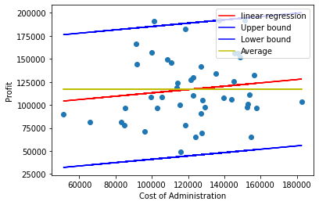
Administration
$$Rumus regresi linear = 0.1811573714930351∗x_{1} + 94972.31935952273$$
$$Batas atas : 0.1811573714930351 ∗x_{1}+ 94972.31935952273 + 2 ∗ 36033.05620722814$$
$$Batas bawah: 0.1811573714930351 ∗x_{1}+ 94972.31935952273 − 2 ∗ 36033.05620722814$$

Slide 9
Administration
$$SSE of profit vs marketing data is 57128770143.86354$$
$$SSR of profit vs R\&D data is 58190484852.560135$$
$$percentage of performance for marketing vs profit is 50.46033713482172$$

Slide 10
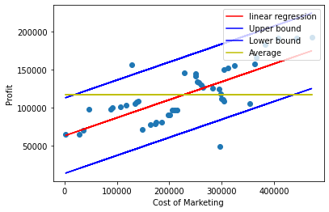
Marketing Spend
$$Rumus regresi linear = 0.2365138910721844∗x_{1} + 63045.78840138968$$
$$Batas atas : 0.2365138910721844 ∗ x_{1} + 63045.78840138968 + 2 ∗ 24765.742002988387$$
$$Batas bawah: 0.2365138910721844 ∗ x_{1} + 63045.78840138968 − 2 ∗ 24765.742002988387$$

Slide 11
Marketing Spend
$$SSE of profit vs marketing data is 26987046986.17766$$
$$SSR of profit vs R\&D data is 58190484852.560135$$
$$percentage of performance for marketing vs profit is 68.31670699584154$$

Slide 12
STATE
California
Florida
New York

Slide 13
01
CALIFORNIA

Slide 14
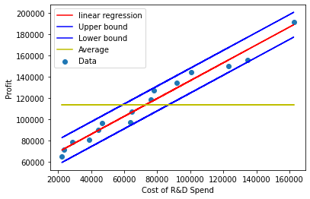

R&D Spend
$$Rumus regresi linear = 0.8403657851867833∗x1 + 52362.21331134203$$
$$Batas atas : 0.8403657851867833 ∗ x1 + 52362.21331134203 + 2 ∗ 5842.670169065692$$
$$BAatas bawah: 0.8403657851867833 ∗ x1 + 52362.21331134203 − 2 ∗ 5842.670169065692$$

Slide 15
R&D Spend
$$SSE of profit vs marketing data is 443778331.1583715$$
$$SSR of profit vs R\&D data is 18372110012.280933$$
$$percentage of performance for marketing vs profit is 97.64147021358623$$

Slide 16
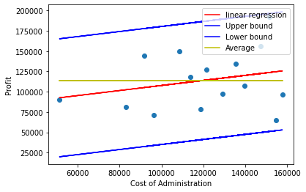

Administration
$$Rumus regresi linear = 0.31067528415442786∗x1 + 76656.29203399968$$
$$Batas atas : 0.31067528415442786 ∗ x1 + 76656.29203399968 + 2 ∗ 36318.38721470936$$
$$Batas bawah: 0.31067528415442786 ∗ x1 + 76656.29203399968 − 2 ∗ 36318.38721470936$$

Slide 17
Administration
$$SSE of profit vs marketing data is 17147328248.408335$$
$$SSR of profit vs R\&D data is 18372110012.280933$$
$$percentage of performance for marketing vs profit is 51.72410069506661$$

Slide 18
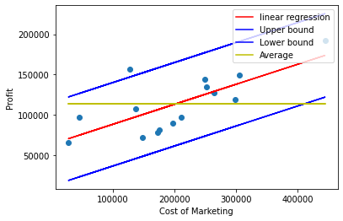
Marketing Spend
$$Rumus regresi linear = 0.24877824387366462∗x1 + 63225.15486780451$$
$$Batas atas : 0.24877824387366462 ∗ x1 + 63225.15486780451 + 2 ∗ 25910.36105822212$$
$$Batas bawah: 0.24877824387366462 ∗ x1 + 63225.15486780451 − 2 ∗ 25910.36105822212$$

Slide 19
Marketing Spend
$$SSE of profit vs marketing data is 8727508532.176632$$
$$SSR of profit vs R\&D data is 18372110012.280933$$
$$percentage of performance for marketing vs profit is 67.79471815125756$$

Slide 20
02
FLORIDA

Slide 21
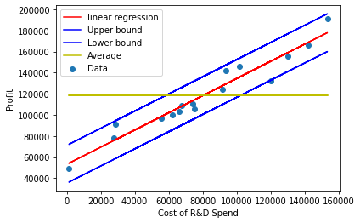
R&D Spend
$$Rumus regresi linear =0.813355124358426∗x_{1}+ 53116.73209926963$$
$$Batas atas :0.813355124358426 ∗ x_{1} + 53116.73209926963 + 2 ∗ 8942.431622472492$$
$$Batas bawah:0.813355124358426 ∗ x_{1} + 53116.73209926963 − 2 ∗ 8942.431622472492$$

Slide 22
R&D Spend
$$SSE of profit vs marketing data is 1119539166.5163438$$
$$SSR of profit vs R\&D data is 19016242865.892197$$
$$percentage of performance for marketing vs profit is 94.44005122465843$$

Slide 23
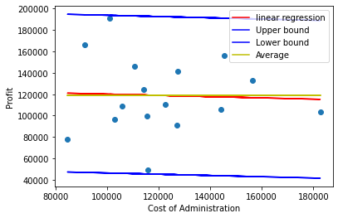
Administration
$$Rumus regresi linear = −0.058704985460230535∗x1 + 125922.46573224581$$
$$Batas atas : −0.058704985460230535 ∗ x1 + 125922.46573224581 + 2 ∗ 36823.00971204951$$
$$Batas bawah: −0.058704985460230535 ∗ x1 + 125922.46573224581 − 2 ∗ 36823.00971204951$$

Slide 24
Administration
$$SSE of profit vs marketing data is 18983076619.551697$$
$$SSR of profit vs R\&D data is 19016242865.892197$$
$$percentage of performance for marketing vs profit is 50.04364057934407$$

Slide 25
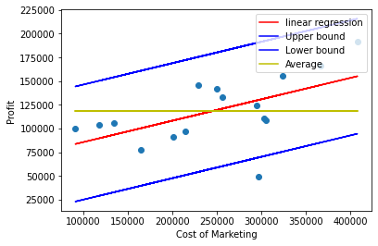
Marketing Spend
$$Rumus regresi linear = 0.22541029749435035∗x1 + 63024.749110378296$$
$$Batas atas : 0.22541029749435035 ∗ x1 + 63024.749110378296 + 2 ∗ 30296.027160780017$$
$$Batas bawah: 0.22541029749435035 ∗ x1 + 63024.749110378296 − 2 ∗ 30296.027160780017$$

Slide 26
Marketing Spend
$$SSE of profit vs marketing data is 12849889664.17409$$
$$SSR of profit vs R\&D data is 19016242865.892197$$
$$percentage of performance for marketing vs profit is 59.675402554577396$$

Slide 27
03
NEW YORK

Slide 28
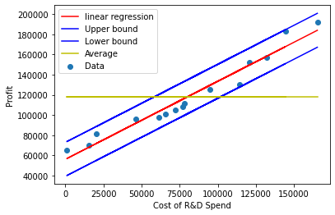
R&D Spend
$$Rumus regresi linear = 0.7728067740825835∗x1 + 56105.661582674235$$
$$Batas atas : 0.7728067740825835 ∗ x1 + 56105.661582674235 + 2 ∗ 8399.944316929159$$
$$Batas bawah: 0.7728067740825835 ∗ x1 + 56105.661582674235 − 2 ∗ 8399.944316929159$$

Slide 29
R&D Spend
$$SSE of profit vs marketing data is 917267838.8576362$$
$$SSR of profit vs R\&D data is 20584028570.075768$$
$$percentage of performance for marketing vs profit is 95.73389519677275$$

Slide 30
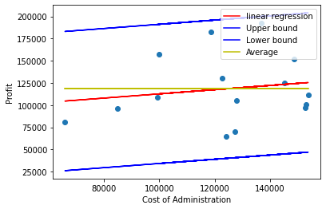
Administration
$$Batas bawah: 0.23770541120170532 ∗ x_{1} + 88869.59268362902 − 2 ∗ 39246.56836272714$$
$$Batas atas : 0.23770541120170532 ∗ x_{1} + 88869.59268362902 + 2 ∗ 39246.56836272714$$
$$Rumus regresi linear = 0.23770541120170532∗x_{1} + 88869.59268362902$$

Slide 31
Administration
$$SSE of profit vs marketing data is 20023810667.252796$$
$$SSR of profit vs R\&D data is 20584028570.075768$$
$$percentage of performance for marketing vs profit is 50.68979033770897$$

Slide 32
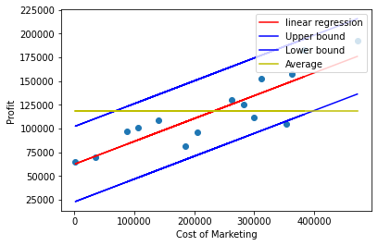
Marketing Spend
$$Rumus regresi linear = 0.2411927460526755∗x1 + 62228.92261014016$$
$$Batas atas : 0.2411927460526755 ∗ x1 + 62228.92261014016 + 2 ∗ 19872.85063640718$$
$$Batas bawah: 0.2411927460526755 ∗ x1 + 62228.92261014016 − 2 ∗ 19872.85063640718$$

Slide 33
Marketing Spend
$$SSE of profit vs marketing data is 5134092501.420341$$
$$SSR of profit vs R\&D data is 20584028570.075768$$
$$percentage of performance for marketing vs profit is 80.03706224436996$$

Slide 34
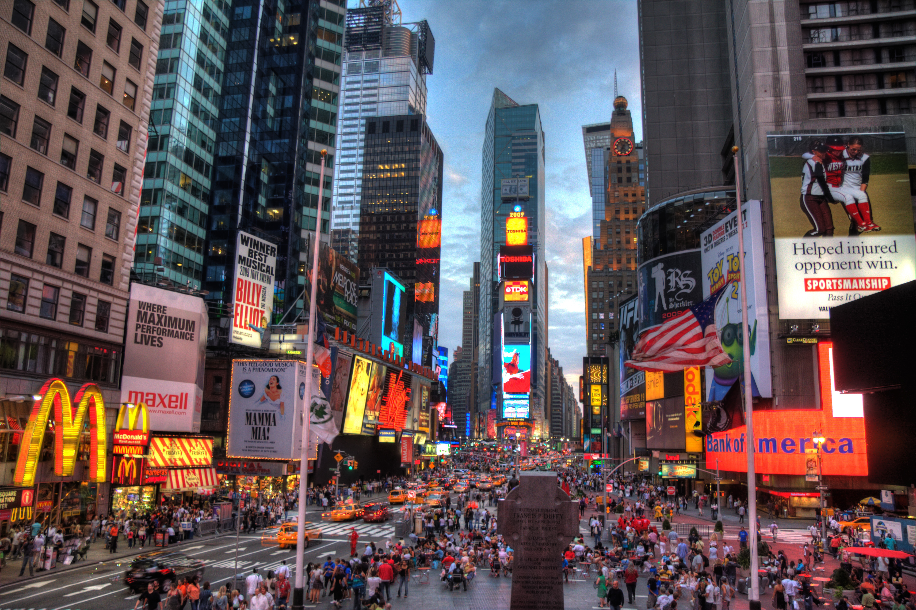
NEW YORK
Times Square NY
Kota yang paling cocok untuk marketing

Slide 35

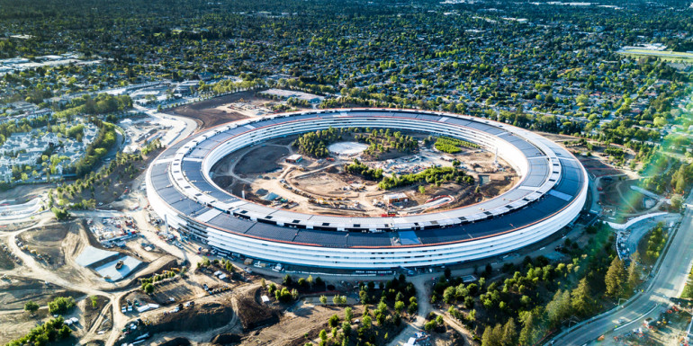
CALIFORNIA
Silicon Valley CA
Kota yang paling cocok untuk R & D

Slide 36
KENDALA YANG DIHADAPI
Menentukan Sigma dalam regresi
Mencocokan data python dengan presentasi

Slide 37
KESIMPULAN
Berdasarkan grafik dan regresi linear dari 46 data perusahaan startup, kita dapat melihat bahwa biaya Administrasi tidak terkait dengan Profit dari perusahaan tersebut.
Profit dari suatu perusahaan lebih dipengaruhi oleh R&D Spend dan juga Marketing Spend.
Hal ini sejalan dengan studi kasus di dunia nyata, bahwa perusahaan yang lebih fokus kepada R&D dan Marketing cenderung memiliki profit lebih tinggi.

Slide 38
THANK
YOU
GOD BLESS

